Slide 1
SMART PUBLIC TOILET
-by
S.Yuvaraj
R.Vishwha
M.Thamizhselven
m.Madhan
Gunal
viswesh

Slide 2
ABSTRACT:
In the cutting edge world, the advances are definitely grown, yet at the same time the cleanliness in our nation is under risk.The abstract of this paper is to deliver clean and hygiene toilets. All the public toilets should be clean and hygiene. In our country, our government has introduced the scheme called “Swachh Bharat” (Clean India). Keeping the toilets uncontaminated is the one of the objective of Clean India scheme. Thispaper can be helpful to encourage the clean India project. In future, it can show the major part in clean India scheme. In an Existing system, they are focused only on identifying the dirt in the toilets. In our proposed system, we have determined on keeping clean toilets, observing the sweeper’s working activities. It can dodge many syndromes. It may create the consciousnessamongst people about the toilet management. Therefore, our development is to use safe and hygienic toilets. This paper is based on IOT and image-processing concepts using different sensors like smell sensor, IR sensor, sonic sensor, RFID reader. By using these sensors, we can create the smart toilets.

Slide 3
INTRODUCTION:
In our country, people do not have enough knowledge of using toilets. This leads to several diseases, such as Malaria, Hepatitis, Flu, Cholera, Streptococcus, Typhoid, etc. Hence we introduce the concept in the IOT called "Swachh Shithouse" The term Swachh means ‘Clean’.
Then the term Shithouse means ‘Toilet’.
It is introduce to use and maintain the toilets in the clean and hygienic way.
The project is based on IOT concepts using different sensors like smell sensor, dirt sensor, sonic sensor, RFID reader, Database.
Using these materials we are trying to provide the clean toilets and create the awareness among the people

Slide 4
SCOPE OF THE PROJECT:
In this paper we are going to provide the clean toilet.
This paper can create the awareness among the people about the clean and hygienic toilets.
This paper can ensure the responsibilities of the sweeper.
Finally, this concept is the one of the stepping stone to the “Clean and disease free India”.

Slide 5
EXISTING SYSTEM:
In an existing system, they concentrate more on organizing sewages from the railway system.
They are trying to taking all the medical tests through the usage of toilets.
They are concentrated on reducing water wastage on toilets, by the implementation of automatic flusher.

Slide 6
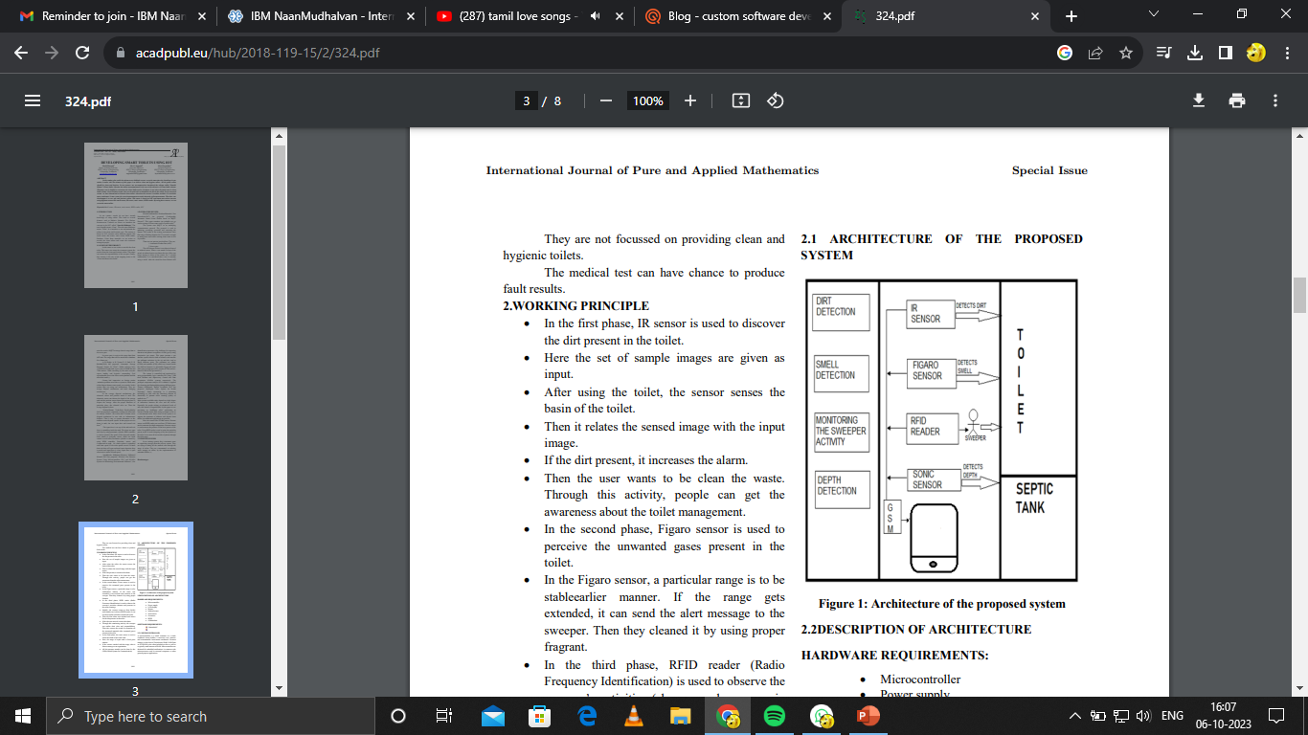
ARCHITECTURE OF THE PROPOSED SYSTEM:

Slide 7
WORKING PRINCIPLE:
In the first phase, IR sensor is used to discover the dirt present in the toilet.
Here the set of sample images are given as input.
After using the toilet, the sensor senses the basin of the toilet.
Then it relates the sensed image with the input image.
If the dirt present, it increases the alarm.
Then the user wants to be clean the waste. Through this activity, people can get the awareness about the toilet management.
In the second phase, Figaro sensor is used to perceive the unwanted gases present in the toilet.
In the Figaro sensor, a particular range is to be stableearlier manner. If the range gets extended, it can send the alert message to the sweeper. Then they cleaned it by using proper fragrant.
In the third phase, RFID reader (Radio Frequency Identification) is used to observe the sweeper’s activities (absence and presence in the toilet cleaning).

Slide 8
Initially, the sweeper wants to show his/her individuality tag in front of RFID reader. It can be shown before and after cleaning the toilet.
Then the first phase gets initiated and senses for the dirt presence in the toilet.
If the dirt gets noticed, it raises the alarm.
Through this monitoring activity, the sweeper can realize their roles and responsibilities. Then they protect the people by disposing all the unwanted materials (dirt, unwanted gases) present in the toilet.
In the final phase, the sonic sensor is used to detect the depth of the septic tank.
Here, the range of septic tank is fixed prior manner. • If the sewage reached with the range, then it directs message to an organization.
• All the message transfer can be done by the GSM (Global System for Communication).

Slide 9
DESCRIPTION OF ARCHITECTURE
HARDWARE REQUIREMENTS:
Microcontroller
Power supply
LCD display
Buzzer
Infrared sensor
Sonicsensor
Gassensor
RFID
GSMmodem
SOFTWARE REQUIREMENTS :
Embedded C

Slide 10
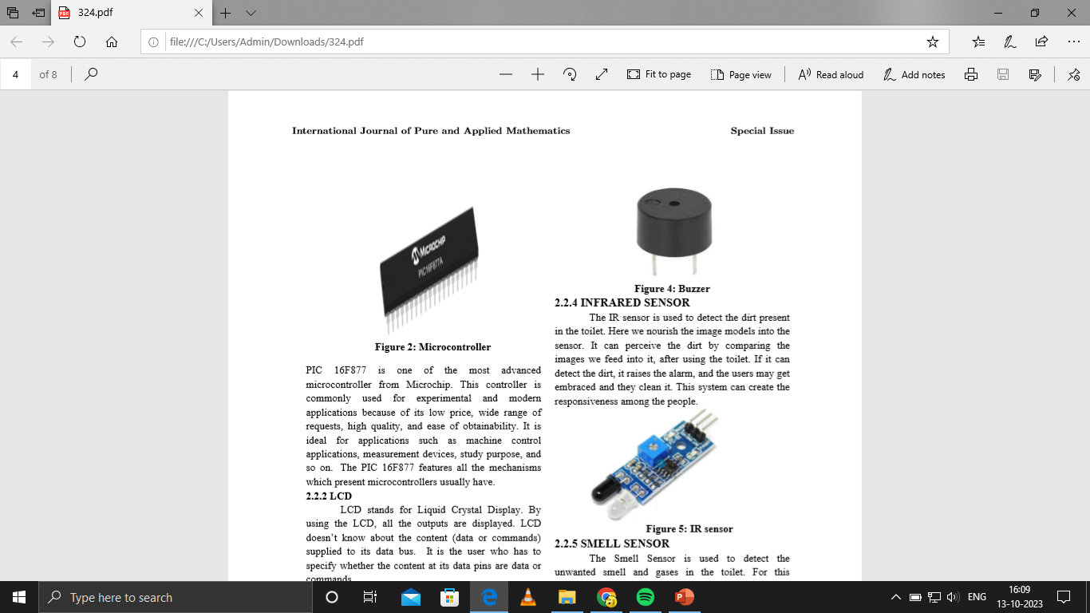
MICROCONTROLLER:
A microcontroller is a small computer on a single combined circuit holding a processor core, memory and programmable input/output peripherals.
Program memory in the form of Ferroelectric RAM, NOR flash or OTP ROM is also often included on chip, as well as a typically small amount of RAM.
Microcontrollers are designed for embedded applications, in contrast to the microprocessors used in personal computers or other general-purpose applications.
International

Slide 11
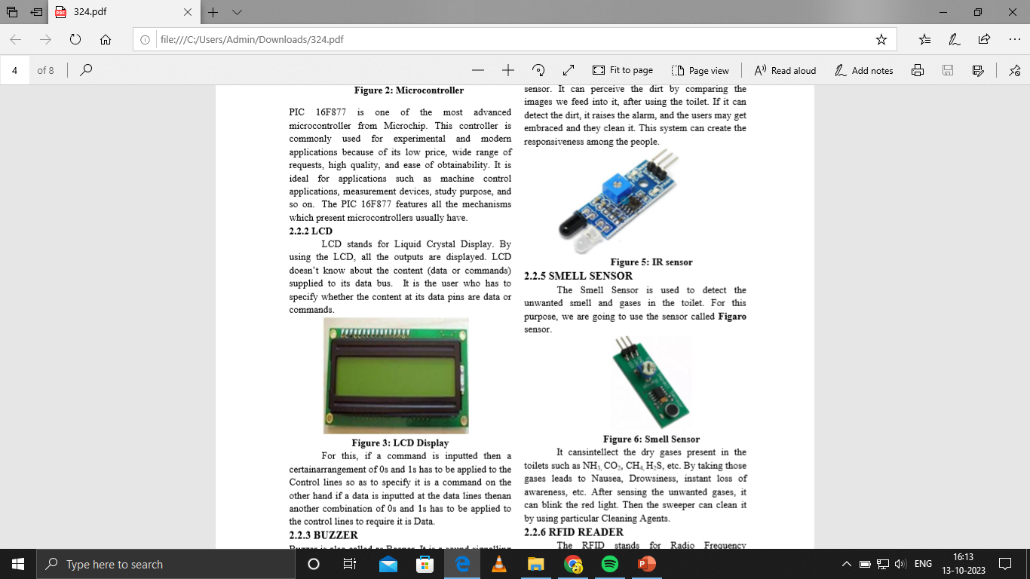
LCD:
LCD stands for Liquid Crystal Display.
By using the LCD, all the outputs are displayed.
LCD doesn’t know about the content (data or commands) supplied to its data bus.
It is the user who has to specify whether the content at its data pins are data or commands.

Slide 12
BUZZER:
Buzzer is also called as Beeper.
It is a sound signalling mechanical device.

Slide 13
INFRARED SENSOR :
The IR sensor is used to detect the dirt present in the toilet. Here we nourish the image models into the sensor.
It can perceive the dirt by comparing the images we feed into it, after using the toilet.
If it can detect the dirt, it raises the alarm, and the users may get embraced and they clean it.
This system can create the responsiveness among the people.

Slide 14
SMELL SENSOR :
The Smell Sensor is used to detect the unwanted smell and gases in the toilet.
For this purpose, we are going to use the sensor called Figaro sensor.

Slide 15
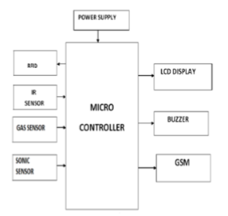
BLOCK DIAGRAM:

Slide 16
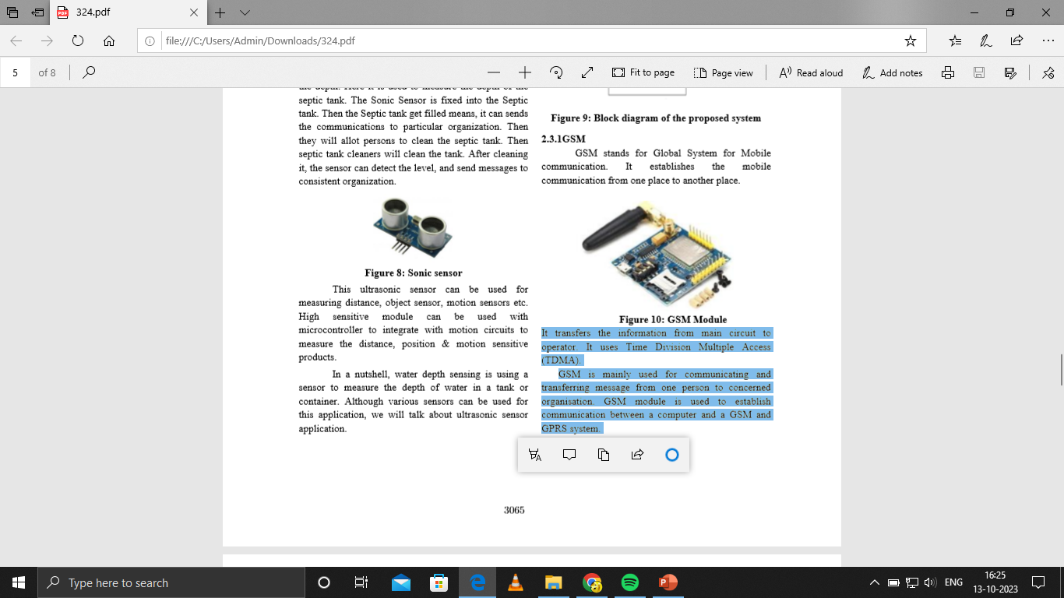
GSM :
It transfers the information from main circuit to operator. It uses Time Division Multiple Access (TDMA).
GSM is mainly used for communicating and transferring message from one person to concerned organisation.
GSM module is used to establish communication between a computer and a GSM and GPRS system.

